Slide 1
Play
Grade 1/2 Social Class

Slide 2
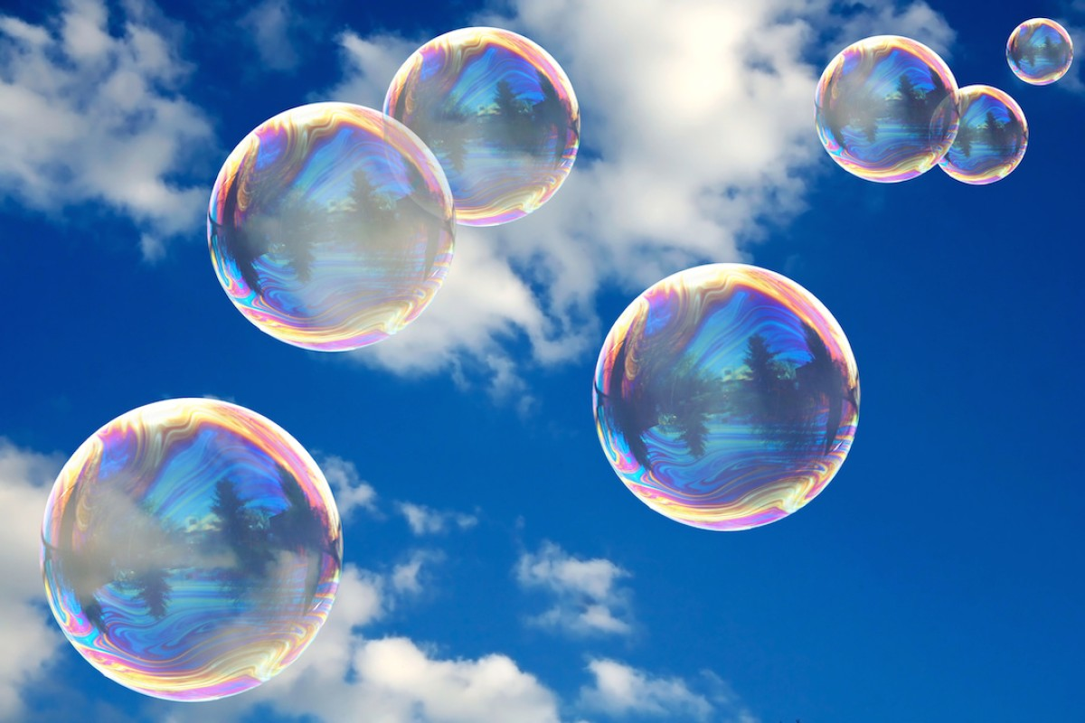
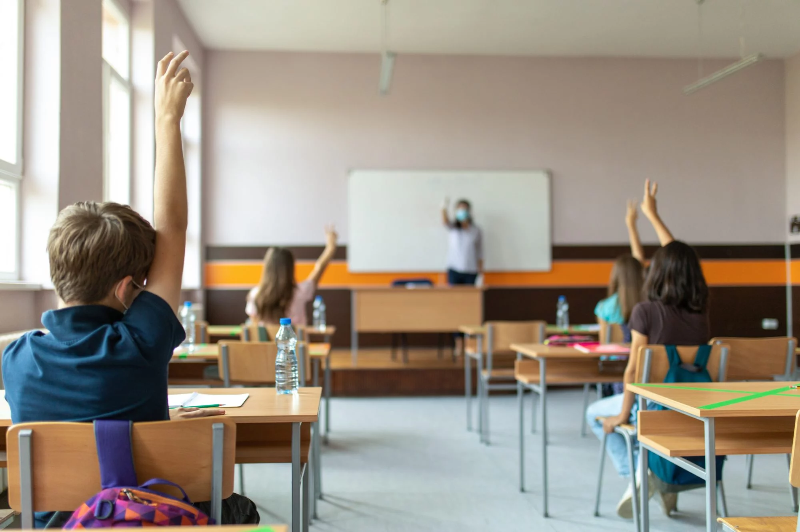
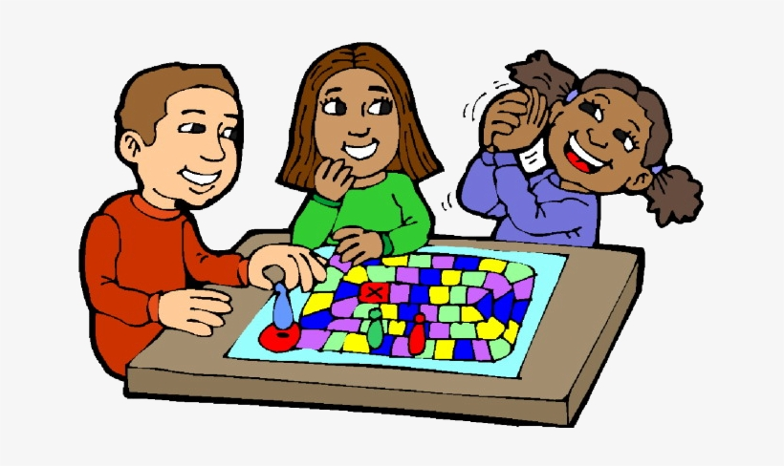
Today’s Plan
Pay attention Talk about play Introduce a game Play a game

Slide 3
3 Parts of Play

Slide 4
3 Parts of Play
Set up
Play
Clean up
Where do you want to spend the most time?

Slide 5
How much time do you want to spend on each part?
Set up Play Clean up

Slide 6
What happens if you took too long to set up?
https://youtu.be/WsAC7LIpRmI (1:33)

Slide 7
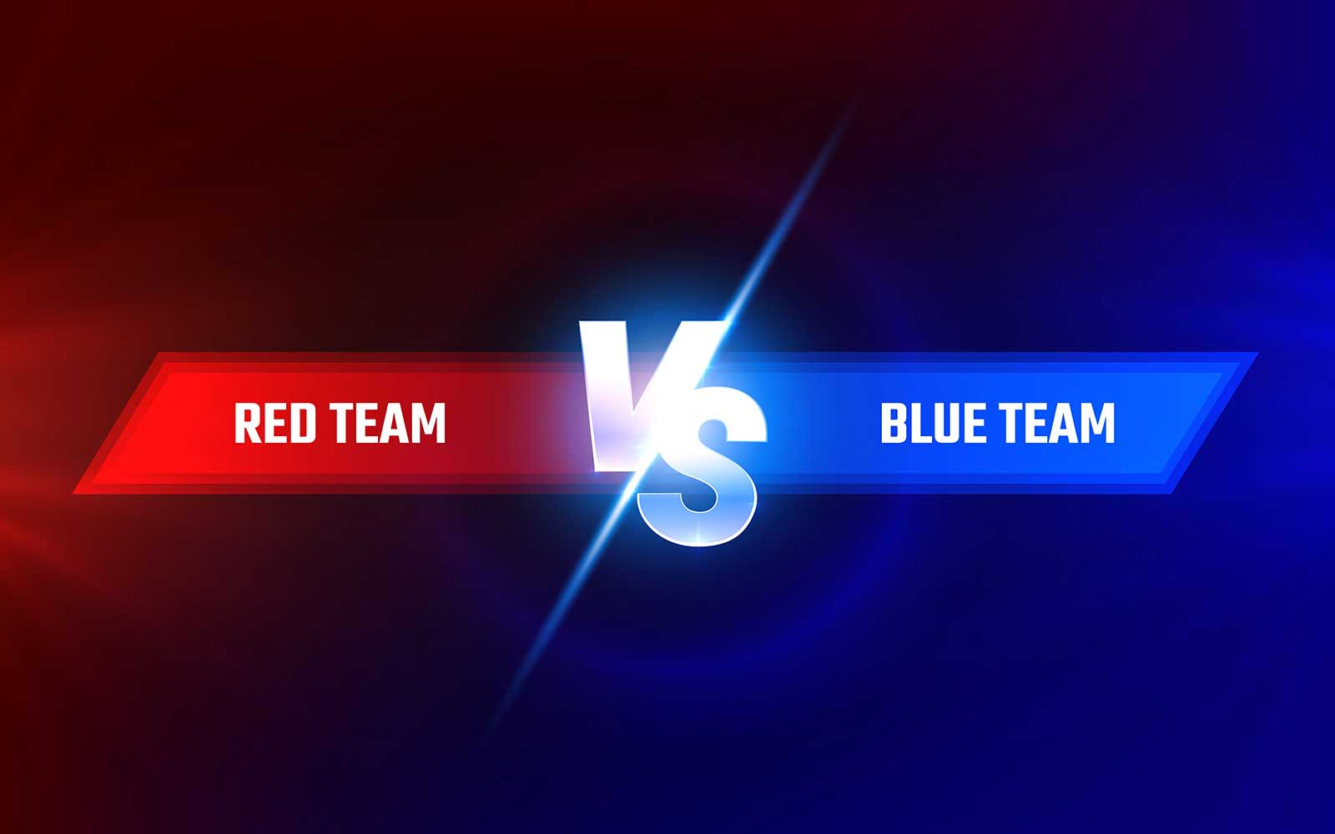
Big problem or little problem?
1 | 2 | 3 | 4 | 5 | 6 | 7 | 8 | 9 | 10

Slide 8
Big problem or little problem?
1 | 2 | 3 | 4 | 5 | 6 | 7 | 8 | 9 | 10

Slide 9
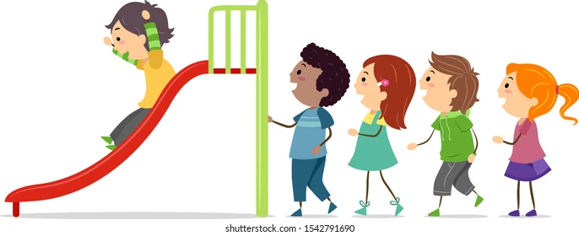
Big problem or little problem?
1 | 2 | 3 | 4 | 5 | 6 | 7 | 8 | 9 | 10

Slide 10
Big problem or little problem?
1 | 2 | 3 | 4 | 5 | 6 | 7 | 8 | 9 | 10

Slide 11
Today’s Game

Slide 12
What Am I?

Slide 13
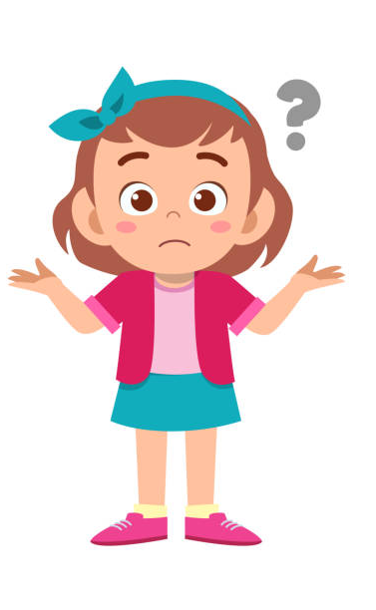
What Am I?

Slide 14
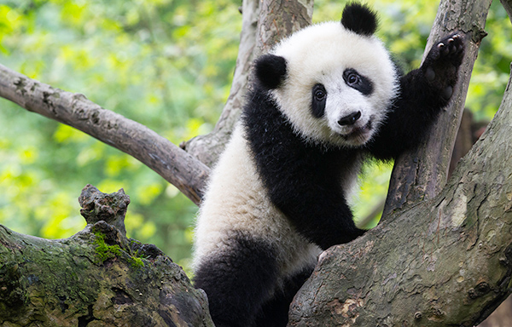
What Am I?
Panda

Slide 15
What Am I?
Is it an animal?
Panda

Slide 16
What Am I?
Does it have four legs?
Panda

Slide 17
What Am I?
Is it chubby?
Panda

Slide 18
What Am I?
Is it a type of bear?
Panda

Slide 19
What Am I?
Is it brown?
Panda

Slide 20
What Am I?
Is it a panda?
Panda

Slide 21
What Am I?
Panda

Slide 22
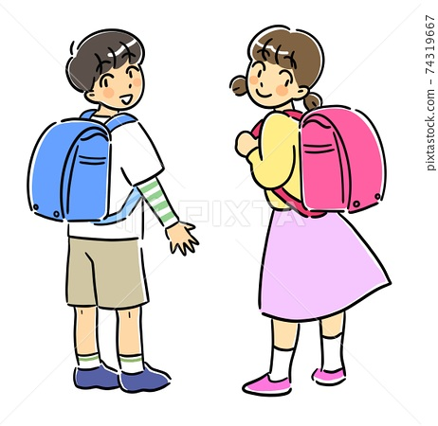
Expected and unexpected behaviors

Slide 23
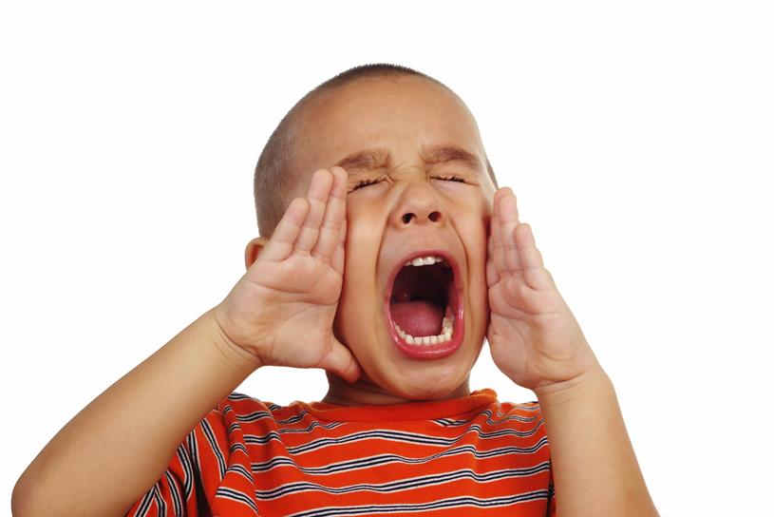
Expected and unexpected behaviors

Slide 24
Expected and unexpected behaviors

Slide 25
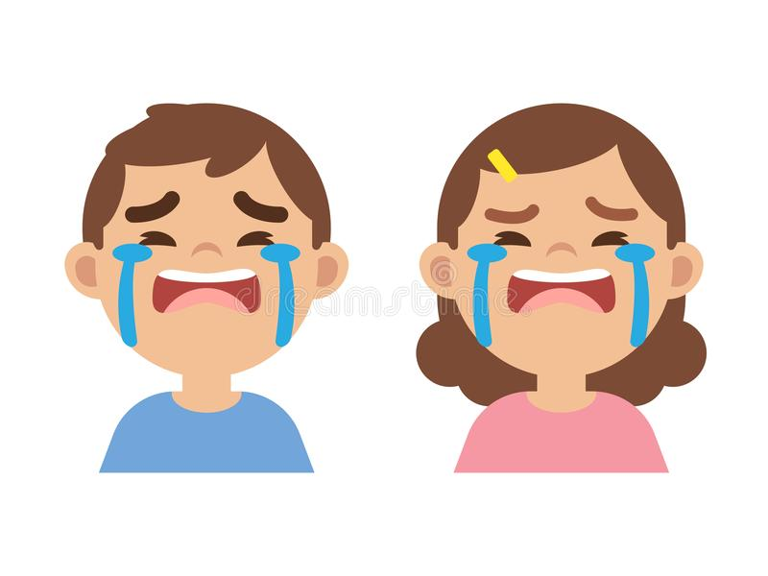
Expected and unexpected behaviors

Slide 26
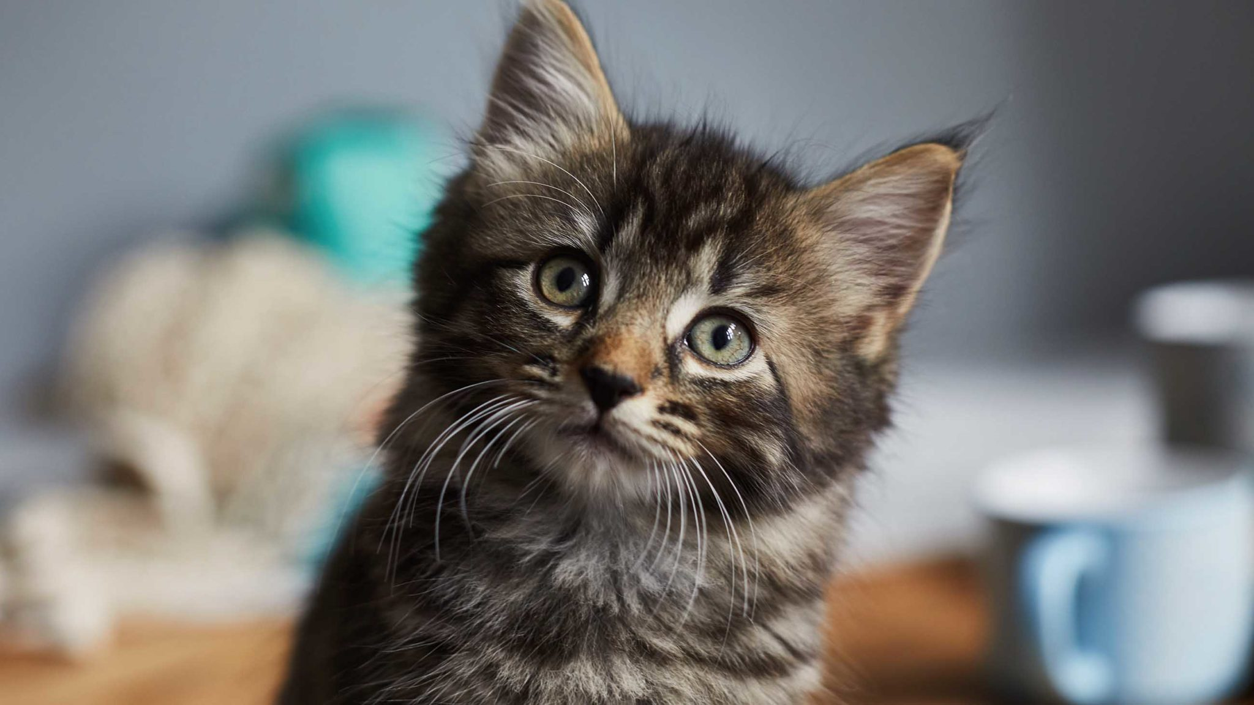
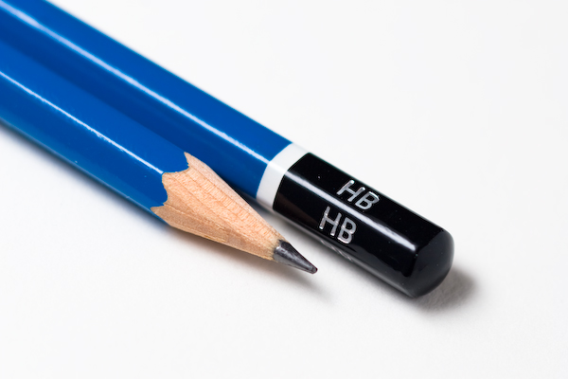
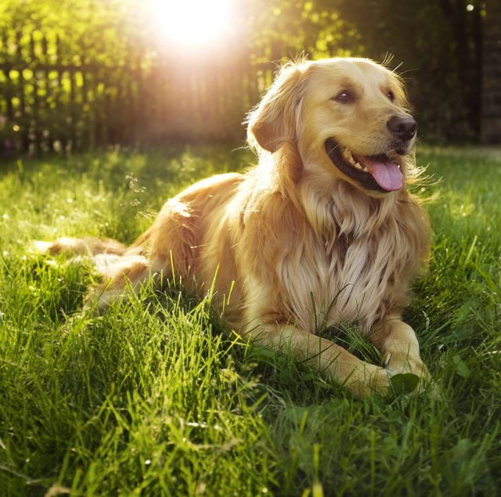
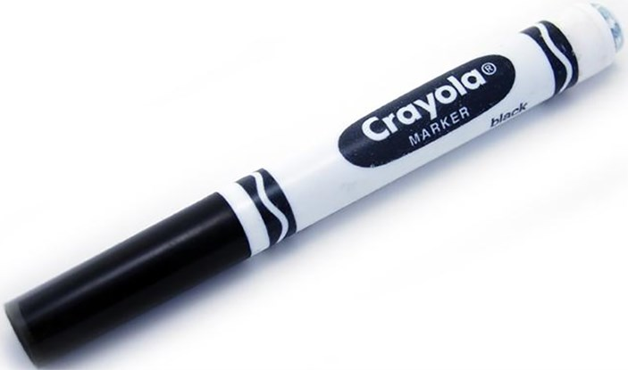
Animals and school stuff

Slide 27
Teachers can help you!
Lists of animals and school things
If you don’t know what to ask …
If you forgot what we have known …

Slide 28
Team Blue vs. Team Red

Slide 29
Get Ready to Play!

Slide 30
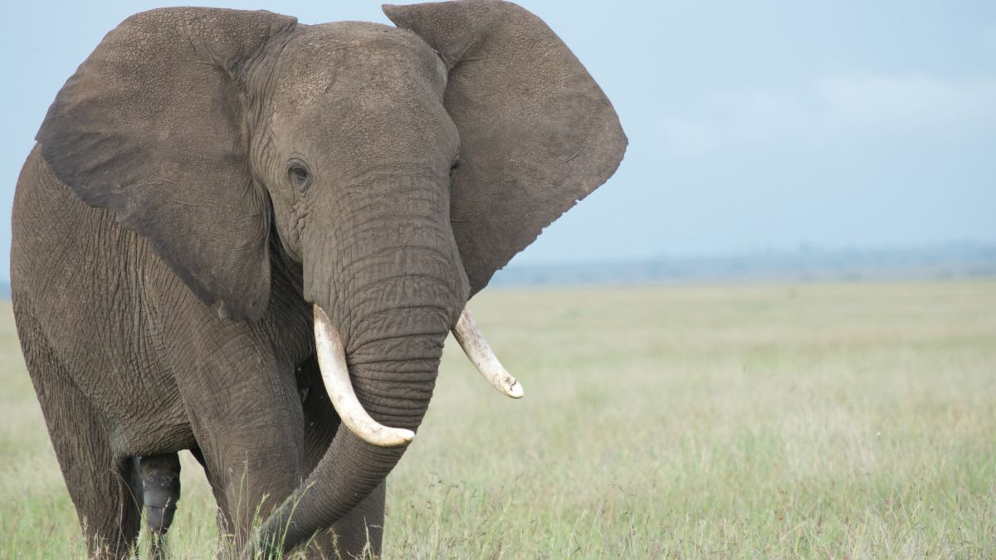
elephant

Slide 31
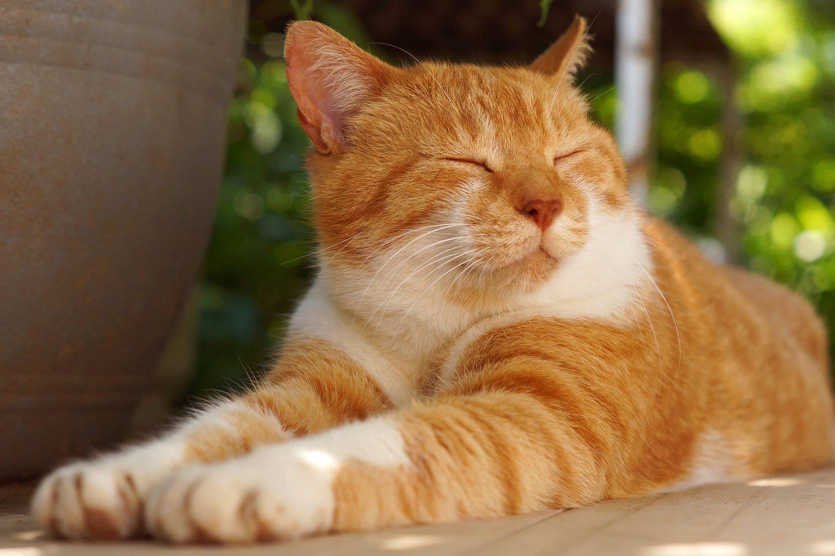
cat

Slide 32
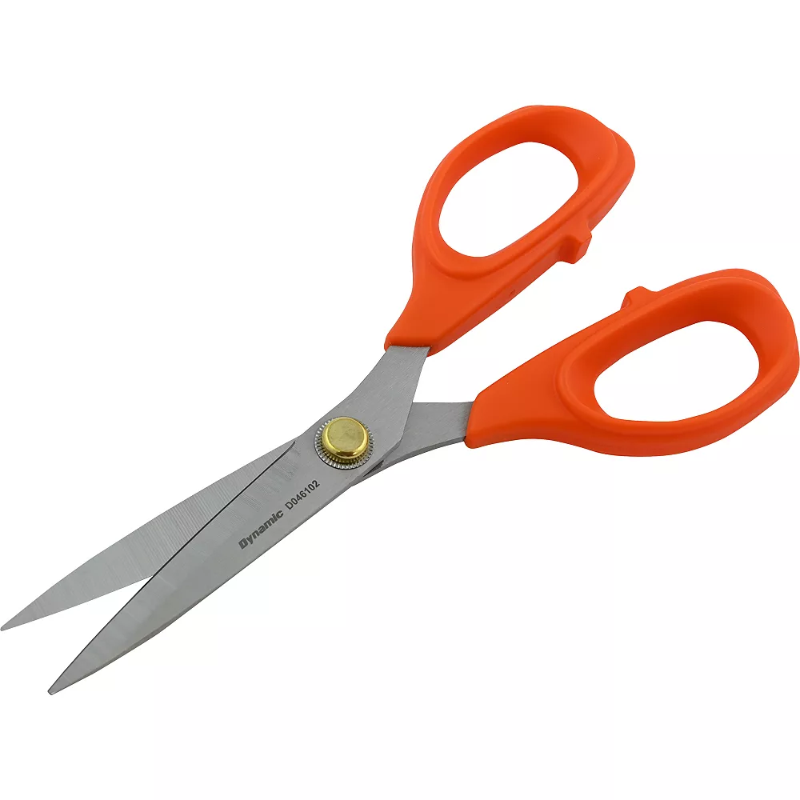
scissors

Slide 33
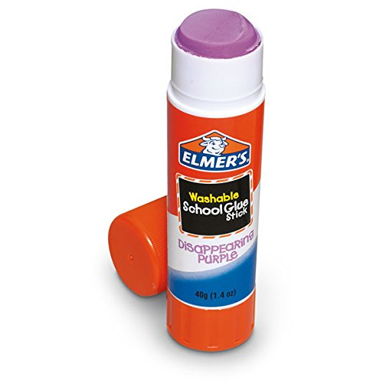
glue stick

Slide 34
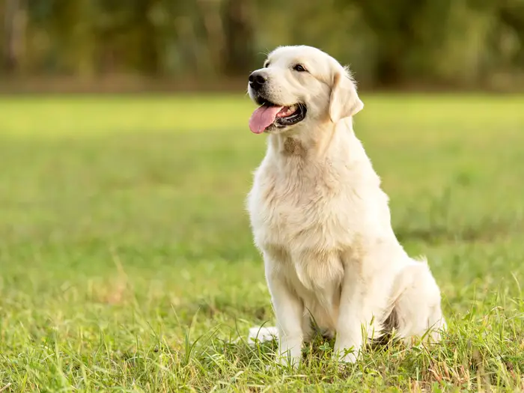
dog

Slide 36
Clean up!

